Slide 1

HINDUSTAN INSTITUTE OF TECHNOLOGY AND SCIENCE
DEPARTMENT OF COMPUTER SCIENCE AND ENGINEERING
CSB 4441: PROJECT AND VIVA-VOCE (Review 3)
Machine Learning Algorithms for Diagnosis of Parkinson's Disease Based on Voice Characteristics
P. SAI MANOJ
19113101
K. SUMANTH KUMAR REDDY
19113105
Supervisor
Dr. SAMBATH M

Slide 2

AGENDA
Project Summary
Introduction
Scope
Motivation
Literature Review
Proposed Method
Objective
Modular Description
Demo & Sample Screenshots
Testing & Evaluation
References

Slide 3
PROJECT SUMMARY
Problem Statement | Solution | Plan for next six weeks
In a Video when the patient is nearest and farthest to the camera the gait features cannot be determined correctly which predicts error. The trajectories obtained using the 2D pose-estimation libraries could not be used to calculate gait parameters such step length that depend on data in the anterior-posterior direction. | The use of machine learning algorithms like Logistic Regression, Support Vector Machine (SVM), K-Nearest Neighbors (KNN), and ensemble approaches such as Gradient Boosting Classifier and Random Forest Classifier and a relevant dataset can help to improve the accuracy and efficiency of Parkinson's disease diagnosis, and support the development of new and more effective treatments. | Feb 4th week: Designing the model March 1st week: Data Preprocessing, Creating the model March 2nd Week: Training and testing March 3rd Week: Implementation & Integration March 4th Week: Ensuring the actual values with predicted values April 1st Week: Calculating the accuracies of algorithms

Slide 4
INTRODUCTION
Parkinson's disease (PD) is a neurodegenerative disorder that affects movement control. Machine learning algorithms have been applied to detect PD by analyzing various clinical and physiological data such as speech, gait, and motor symptoms.
These algorithms use various techniques such as Logistic Regression, Support Vector Machine (SVM), K-Nearest Neighbors (KNN), and ensemble approaches such as Gradient Boosting Classifier and Random Forest Classifier to classify individuals as either having PD or not.
The algorithms learn patterns in the data through training on large datasets and can then make predictions about new, unseen data.
The use of machine learning for PD detection can help in early diagnosis and improve the accuracy of current diagnostic methods.

Slide 5
SCOPE AND MOTIVATION
The scope of a project on detecting Parkinson's disease using machine learning typically involves using data from various sources, such as speech and movement patterns, to train a model that can accurately diagnose the disease.
The motivation for this project is to develop a non-invasive and efficient method for early diagnosis of Parkinson's disease, which can lead to better patient outcomes and a better understanding of the disease.

Slide 6
OBJECTIVES
The objective of this project is using machine learning algorithms like Support Vector Machine (SVM), Logistic Regression, and Naive Bayes for detecting Parkinson's disease is to build a model that can accurately diagnose the disease based on various vocal features.
Training the machine learning algorithms using the selected features and a labeled dataset of patients diagnosed with Parkinson's disease and healthy individuals.
Evaluating the performance of the trained models by measuring metrics such as accuracy, precision, recall, F1 score, etc.
To integrate the model according to few selected features which we are used to differentiate and identifying the disease.

Slide 7
LITERATURE REVIEW
S.NO | TITLE | JOURNAL/CONFERENCE & YEAR OF PUBLICATION | METHODOLOGY | LIMITATIONS
1. | Concurrent Validity of Zeno Instrumented Walkway and Video-Based Gait Features in Adults With Parkinson’s Disease | IEEE Journal of Translational Engineering in Health and Medicine, 2021 | Three 2D human pose-estimation libraries (AlphaPose, Detectron, OpenPose) and one 3D library (ROMP) are used to calculate gait features from colour video and correlate them with those extracted by a Zeno instrumented walkway. | The trajectories obtained using the 2D pose-estimation libraries could not be used to calculate gait parameters such step length that depend on data in the anterior-posterior direction.
2. | Multi-scale sparse graph convolutional network for the assessment of Parkinsonian gait | IEEE Transactions on Multimedia, 2021 | Proposed a novel two-stream spatial-temporal attention graph convolutional network (2s-ST-AGCN) for video assessment of PD gait motor disorder. | Method is designed for a gait motor assessment in PD; hence, its generality is limited. It is difficult to minimize to classification errors.

Slide 8
LITERATURE REVIEW
S.NO | TITLE | JOURNAL/CONFERENCE & YEAR OF PUBLICATION | METHODOLOGY | LIMITATIONS
3. | Validation of IMU-based gait event detection during curved walking and turning in older adults and Parkinson’s Disease patients | Journal of NeuroEngineering and Rehabilitation, 2021 | Shank-mounted IMUs are used to detect gait events from steps during straight-line and curved walking, under both single-task and dual-task conditions, in different neurological populations. | Gait events from steps during turns can be detected but result in more missed events and more false events. In case spatio-temporal parameters are subsequently derived, the higher number of missed and false events will have a negative effect.
4. | Measuring gait variables using computer vision to assess mobility and fall risk in older adults with dementia | IEEE Journal of Translational Engineering in Health and Medicine, 2020 | Using the tracked pose information, gait features were extracted from video recordings of gait bouts and their association with clinical mobility assessment scores and future falls data was examined. | Due to the nature of the specialized dementia unit, patients are typically admitted for 6-8 weeks, limiting data collection to that time, and limiting the ability to perform longer term longitudinal analysis.

Slide 9
LITERATURE REVIEW
S.NO | TITLE | JOURNAL/CONFERENCE & YEAR OF PUBLICATION | METHODOLOGY | LIMITATIONS
5. | Random Forest Classifier based detection of Parkinson’s disease | Association of Cell Biology Romania, 2021 | Random Forest Classifier is used to detect the Parkinson’s disease using the voice speech of the patients dataset. | Random Forest Classifier is a black box model, which makes it difficult to understand how the model is making predictions. It can be computationally expensive, especially for large datasets or complex models.
6. | Optimized grass hopper algorithm for diagnosis of Parkinson’s disease | Springer Nature Journal | Different Parkinson Disease datasets are compiled from handwriting tests to recordings of sound (audio), on these datasets GOA algorithm is applied. | OGA is prone to overfitting, which occurs when the model is too complex and fits the training data too well, but fails to generalize to new data.

Slide 10
Proposed Method
Logistic Regression, SVM, KNN are supervised learning algorithms and ensemble approaches such as Gradient Boosting Classifier and Random Forest Classifier are used.
A group of machine learning approaches known as ensemble methods combine several models to provide predictions. Specifically, we used two different algorithms, SVM and Random Forest Classifier, and combined them using the voting classifier.
Two pre-processing techniques are employed, they are standard scalar and principal component analysis (PCA), to pre-process the data prior to training our machine learning model.
The data will be divided into training and testing sets, and to perform cross-validation to avoid overfitting.
To build this model, a labeled dataset of patients with and without Parkinson's disease is used. It will train the algorithms on this dataset, and compare their performance in terms of metrics such as accuracy, precision, recall, F1-score, etc.

Slide 11
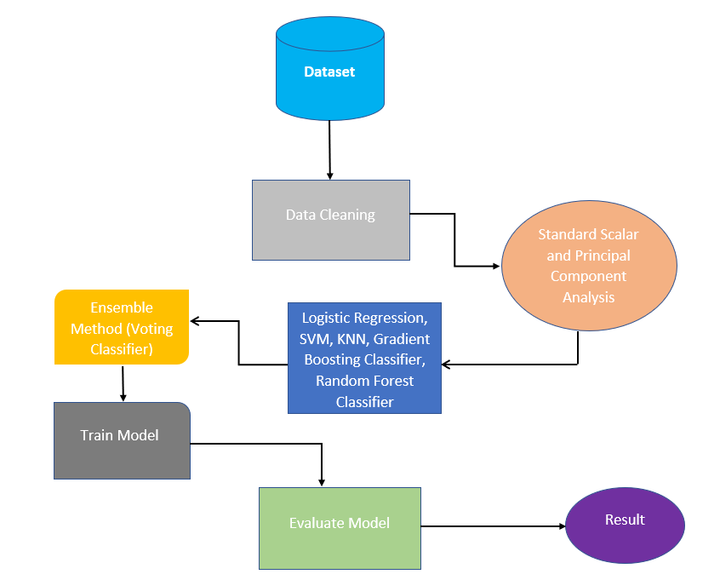
System Design – ARCHITECTURE

Slide 12
Modules
Dataset Description
Data Cleaning
Machine learning algorithms
Ensemble method
Evaluation Methods
Evaluation Metrics

Slide 13
Modules
Dataset Description :
Patients with Parkinson's disease donated the voice feature dataset that was utilised in this investigation. The Kaggle platform is where the dataset was gathered. The dataset has 756 cases and 23 characteristics, including jitter, shimmer, and harmonics-to-noise ratio (HNR).
Data Cleaning :
Two pre-processing techniques are employed, they are standard scalar and principal component analysis (PCA), to pre-process the data prior to training our machine learning model. Standard scalar is a commonly used technique that involves scaling the features to have zero mean and unit variance.
PCA is used to reduce the dimensionality of the data. PCA is a technique that involves transforming the original features into a new set of features that are linearly uncorrelated and capture the most important variables in the data.

Slide 14
Machine learning algorithms
The use of machine learning methods such as Random Forest Classifier, Gradient Boosting Classifier, KNN, SVM, and Logistic Regression.
The best tools for preparing classification and regression concerns are logistic regression, KNN, and SVM. The two most popular machine learning algorithms are Random Forest and Gradient Boosting.
Both models are ensembles, which means they combine a number of weak learners to produce a powerful learner.
While using the same weak learner, Random Forest and Gradient Boosting are very distinct algorithms.

Slide 15
Ensemble method
A group of machine learning approaches known as ensemble methods combine several models to provide predictions. Specifically, used two different algorithms, SVM and Random Forest Classifier, and combined them using the voting classifier.
The voting classifier is a simple ensemble method that aggregates the predictions of multiple models by taking the majority vote.
In our case, we combined the predictions of the SVM and Random Forest Classifier to make the final prediction.

Slide 16
Evaluation Methods
Two common evaluation methods, cross-validation with 5-fold validation and grid search are applied. Together, cross-validation and grid search allows to evaluate how well our machine-learning model is performing on multiple subsets of the data and to identify the best hyperparameters for the model.
This approach enables to obtain reliable estimates of the model's performance and to optimize its performance for our specific dataset.

Slide 17
Evaluation Metrics
Several evaluation metrics are used which allow us to measure the accuracy, precision, recall, and overall performance of the model. Additionally, we used receiver operating characteristic (ROC) curves and confusion matrices, also known as error matrices, to illustrate the classification performance of the suggested machine learning methods.
Additionally, the area under the ROC curve was used to gauge how effective the model was (AUC). Higher AUC values are a sign of better categorization results.

Slide 18
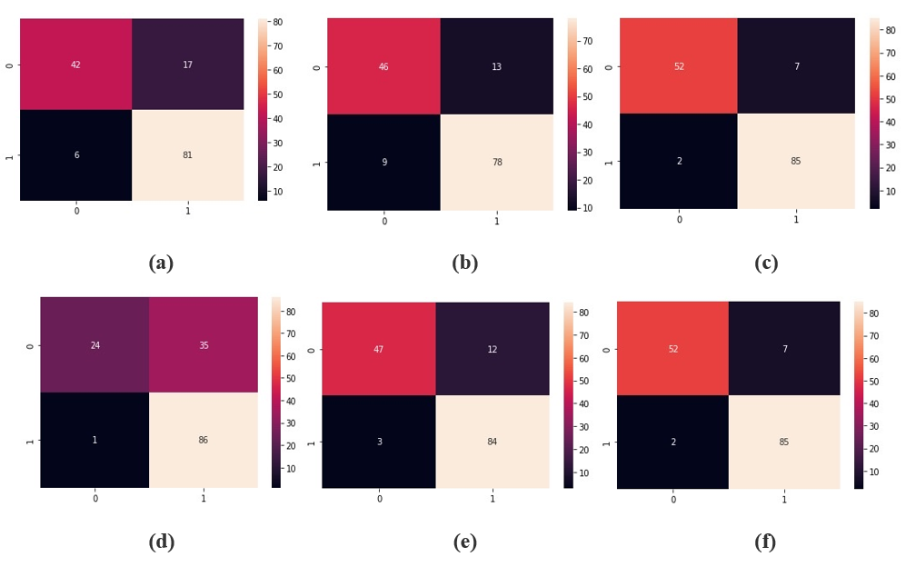
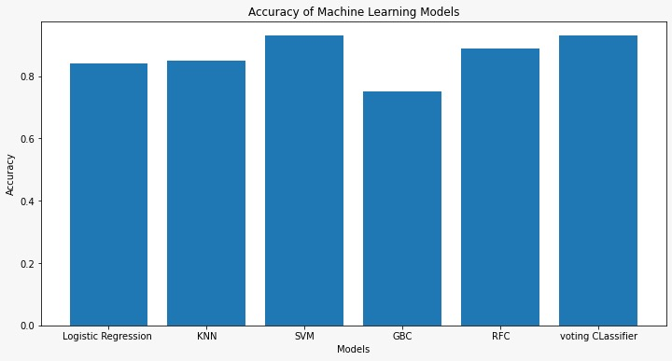
Demo & Sample Screenshots

Slide 19
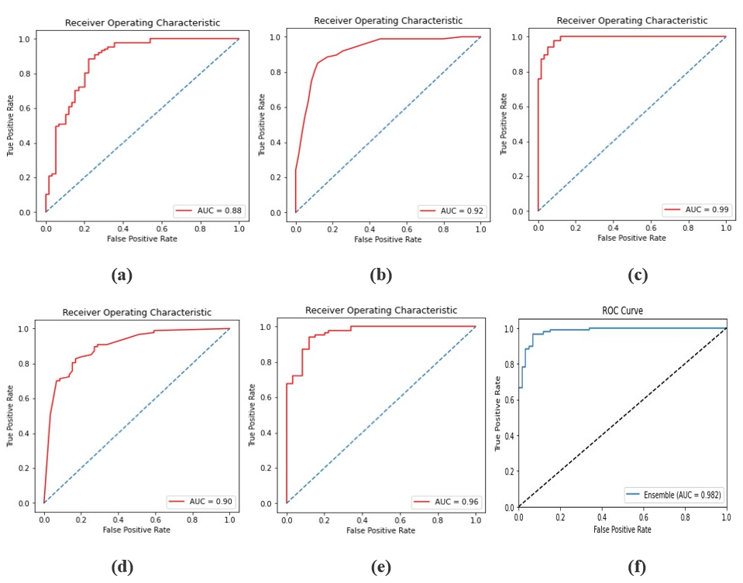
Testing & Evaluation

Slide 20
References
[1] Salgueiro, A. D. J. P., Shichkina, Y., García, A. G., & Rodríguez, L. G. (2021). Parkinson’s disease classification and medication adherence monitoring using smartphone-based gait assessment and deep reinforcement learning algorithm. Procedia Computer Science, 186, 546-554.
[2] Mohammadi, A. G., Mehralian, P., Naseri, A., & Sajedi, H. (2021). Parkinson's disease diagnosis: The effect of autoencoders on extracting features from vocal characteristics. Array, 11, 100079.
[3] Belić, M., Bobić, V., Badža, M., Šolaja, N., Đurić-Jovičić, M., & Kostić, V. S. (2019). Artificial intelligence for assisting diagnostics and assessment of Parkinson’s disease—A review. Clinical neurology and neurosurgery, 184, 105442.
[4] Gunduz, H. (2021). An efficient dimensionality reduction method using filter-based feature selection and variational autoencoders on Parkinson's disease classification. Biomedical Signal Processing and Control, 66, 102452.
[5] Mohammed, M. A., Elhoseny, M., Abdulkareem, K. H., Mostafa, S. A., & Maashi, M. S. (2021). A multi-agent feature selection and hybrid classification model for Parkinson's disease diagnosis. ACM Transactions on Multimidia Computing Communications and Applications, 17(2s), 1-22.

Slide 21
References
[6] Haq, A. U., Li, J. P., Memon, M. H., Malik, A., Ahmad, T., Ali, A., ... & Shahid, M. (2019). Feature selection based on L1-norm support vector machine and effective recognition system for Parkinson’s disease using voice recordings. IEEE access, 7, 37718-37734.
[7] Sathiya, T., Reenadevi, R., & Sathiyabhama, B. (2021). Random Forest Classifier based detection of Parkinson’s disease. Annals of the Romanian Society for Cell Biology, 2980-2987.
[8] Masud, M., Singh, P., Gaba, G. S., Kaur, A., Alroobaea, R., Alrashoud, M., & Alqahtani, S. A. (2021). CROWD: crow search and deep learning-based feature extractor for classification of Parkinson’s disease. ACM Transactions on Internet Technology (TOIT), 21(3), 1-18.
[9] Tsai, C. C., Chen, Y. L., Lu, C. S., Cheng, J. S., Weng, Y. H., Lin, S. H., ... & Wang, J. J. (2022). Diffusion tensor imaging for the differential diagnosis of Parkinsonism by machine learning. Biomedical Journal.
[10] Mittal, V., & Sharma, R. K. (2021). Machine learning approach for classification of Parkinson disease using acoustic features. Journal of Reliable Intelligent Environments, 7(3), 233.

Slide 22
Thank You

